Slide 1
Gain and Lift Charts

Slide 2
Gains and Lifts Charts
• In some business problems, it is not good enough to just classify. For example, in direct mail or phone marketing campaigns, where it costs money to send a mail to each prospect, it is better to be able to rank the prospective buyers by their probability to buy. That way, you can order them and start calling or mailing them in their decreasing order of propensity to buy.
• Lift is a measure of the effectiveness of a predictive model calculated as the ratio between the results obtained with and without the predictive model (random selection).
A Lift Chart describes how well a model ranks samples in a particular class.
• The greater the area between the lift curve and the baseline (random selection), the better the model.

Slide 3
Gains and Lift Charts
A company sends mail catalogs to prospective buyers. It costs the company $1 to print and mail one catalog.
From past data, they know the response rate is 5%, i.e., if 100,000 prospective customers are contacted, 5000 buy.
This means that if there is no model and the company randomly contacts the prospects, they will have the following result.
No. of customers contacted | No. of Responses
10000 | 500
20000 | 1000
30000 | 1500
. | .
. | .
100000 | 5000

Slide 4
Gains and Lift Charts
With a predictive model, where the model assigns a probability to each customer, the customers are ordered and divided into deciles (or any other quantiles). They are then called in decreasing order of probability to buy.
Cost | Decile Contacted | Cumulative Response
10000 | 10 (top decile) | 1500
20000 | 9 | 2500
30000 | 8 | 3500
. | . | .
. | . | .
100000 | 1 | 5000

Slide 5
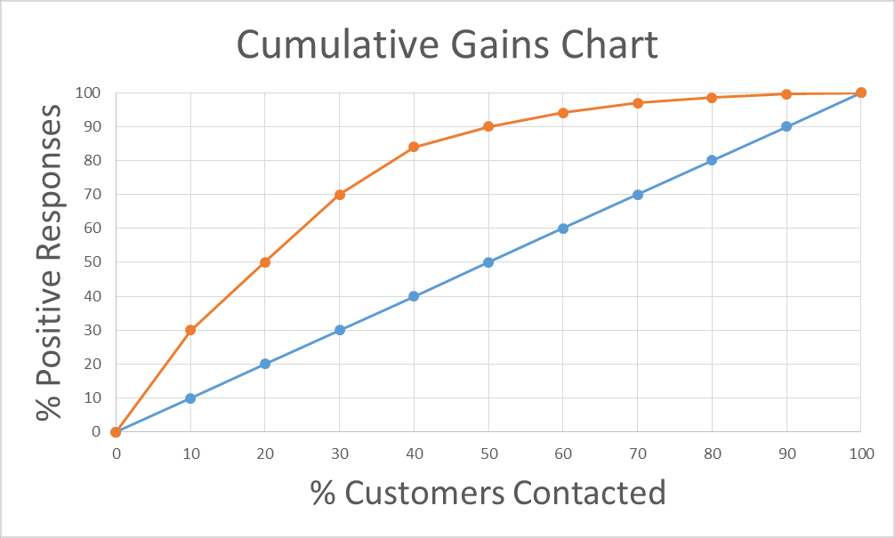
Cost | Decile Contacted | Cumulative Response
10000 | 10 (top decile) | 1500
20000 | 9 | 2500
30000 | 8 | 3500
. | . | .
. | . | .
100000 | 1 | 5000

Slide 6
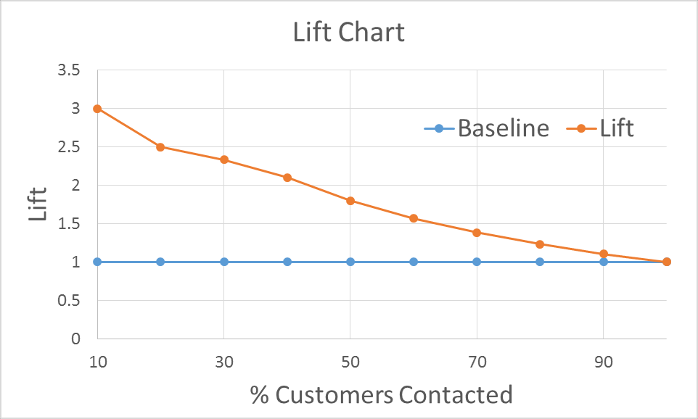
Max lift of 3 at the top decile.
• Model advantage diminishes as more customers are contacted, especially in lower deciles.
• Useful to compare Different model

Slide 7
Evaluating Model Accuracy and Bias-Variance Tradeoff

Slide 8
The Ultimate Test of Model Accuracy
• Holdout set: Split data into train, validation and test sets (in 70:20:10 or 60:20:20, etc. ratios), and ensure model performance is similar.
• Training Set: For fitting a model
• Validation Set: For selecting a model based on estimated prediction errors
• Test Set: For assessing selected model’s performance on “new” data
• k-fold cross-validation: Same as holdout but useful when the data size is small.

Slide 9
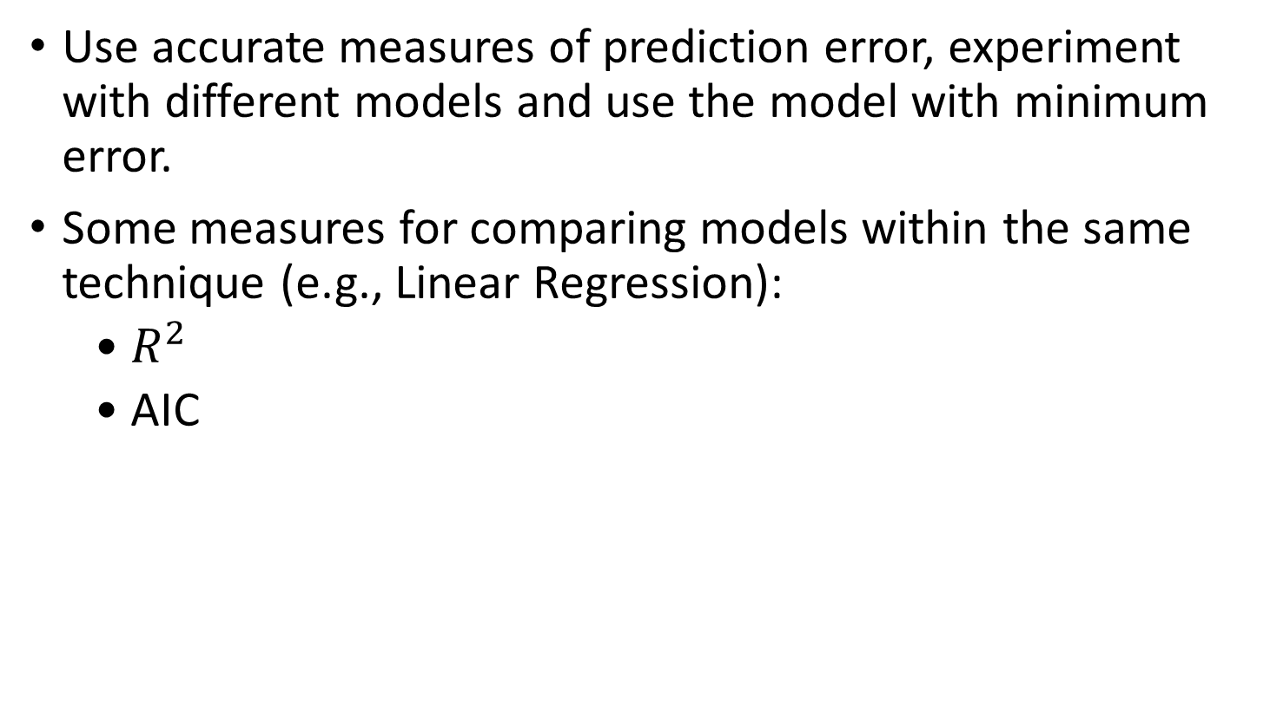
Appropriate Error Measure for Evaluating Accuracy
Use accurate measures of prediction error, experiment with different models and use the model with minimum error.
Some measures for comparing models within the same technique (e.g., Linear Regression):
• $R^{2}$
• AIC

Slide 10
Appropriate Error Measure for Evaluating Accuracy
Some measures for comparing models across techniques:
• MAE (Mean Absolute Error): Mean of the absolute value of the differencebetween the predicted and actual values.
• MAPE (Mean Absolute Percentage Error): Same as above but converted into percentages to allow for comparison across different scales (e.g., comparing accuracies of forecasts on BSE vs NSE).
• RMSE (Root Mean Square Error): Accounts for infrequent large errors, whose impact may be understated by the mean-based error measures.

Slide 11
Bias-Variance Tradeoff
Total error is composed of Bias, Variance and a Random irreducible error. Bias and Variance can be managed.
• If the model performance on training and testing data sets is inconsistent, it indicates a problem either with Bias or Variance.

Slide 12
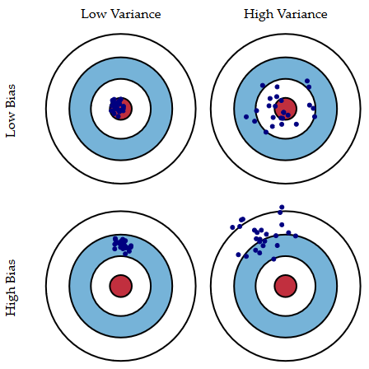
Bias-Variance Tradeoff
Bulls-eye is a model that correctly predicts the real values.
Each hit is a model based on chance variability in training datasets.

Slide 13
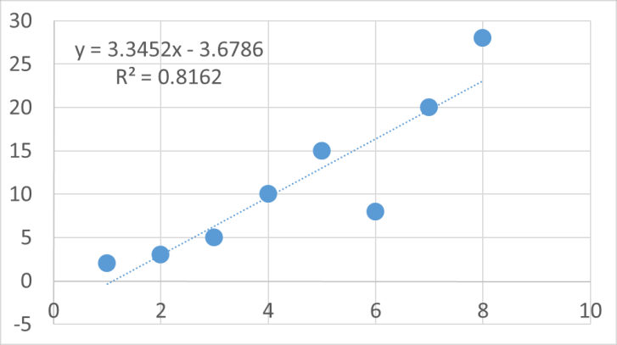
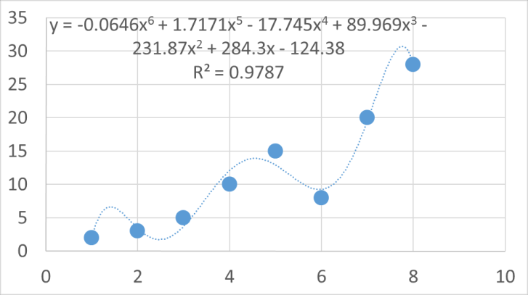
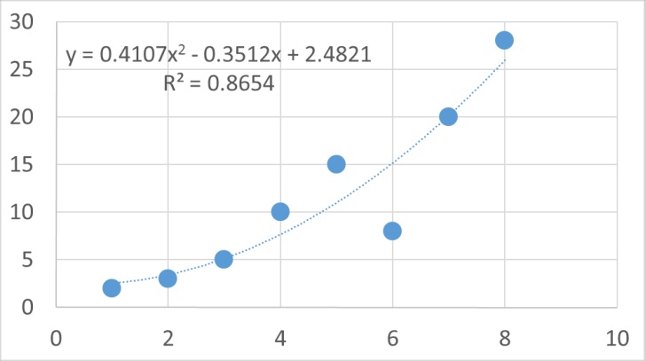
Bias-Variance Tradeoff and Under fitting vs Over fitting Excel
Too Simple a Model Under fit
Too Complex a Model Over fit
Right Model Reasonable fit

Slide 14
Bias-Variance Tradeoff and Under fitting vs Over fitting

Slide 15
Bias-Variance Tradeoff
Ways of detecting and minimizing Bias and Variance
Outliers and Influential Observations can cause statistical bias. Can be identified using various methods like Box plots, points outside ±2 𝑜𝑟 ± 3 standard deviations/errors, residual plots, etc.
Bias cannot be corrected by increasing training sample size.
Variance or standard error can be minimized by increasing training sample size.
Bagging (bootstrap aggregating) techniques (taught later in the program) can be used to minimize errors.

Slide 16
Reference
Business Statistics

